Slide 1
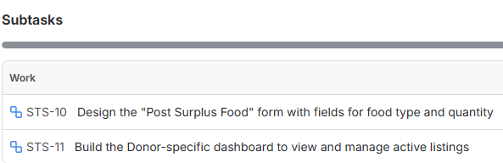
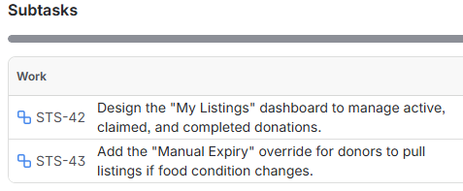
Sourav Saha
Donor Relations & Engagement
Sprint 1
Donor Surplus Control
Sprint 2
Donor Surplus Control

Slide 2
Sourav Saha
Donor Relations & Engagement
Sprint 1
Donor Surplus Control
Sprint 2
Donor Surplus Control

